Slide 1


Platform for Overdue Receivables
Connecting Sellers and Buyers
Eppu Hassinen
Jarmo Tahvanainen
Risto Teerikoski
Notes:
Slide 1: Title Slide Hi, I’m [Your Name], and I’m here to introduce BidWise, a platform to trade overdue receivables.

Slide 2

Background
We are experienced in debt collection and debt purchasing.
Many companies face challenges with unpaid invoices.
Larger companies sell overdue receivables for quicker cash flow.
Smaller companies uses debt collection services.
Selling receivables is a growing trend with significant potential for smaller businesses.
BidWise offers a simple and effective way to improve how overdue receivables are managed.
Notes:
Our team has a great experience in debt collection and debt purchasing, giving us a clear understanding of the challenges companies face.
Unpaid invoices are a common issue,
and while larger companies often sell their overdue receivables to improve cash flow,
smaller businesses still uses traditional debt collection services.
However, selling receivables is becoming a more popular solution. This trend has great potential for smaller companies to improve their cash flow and reduce financial risks.
That’s where BidWise comes in — providing a simple and effective way to help companies manage overdue receivables more efficiently.

Slide 3














Sellers & Buyers
Notes:
This slide shows our two key groups:
sellers, on the left, the ones with overdue receivables, and
buyers, on the right, searching for portfolios to buy.
BidWise connects these groups for easier and faster transactions.

Slide 4







Sellers
Buyers
What a mess!
Current way
Where are all the buyers?
There’s gotta be an easier way?
Where dem’ portfolios!
Notes:
This is the current way of selling and buying overdue receivables.
For seller Selling overdue receivables for quick cash flow is complicated. And also Buyers struggle to find opportunities.
The current process is slow, unclear, and frustrating for both sides, showing the need for a simple and fast solution.

Slide 5









Introducing BidWise
Upload
Wait for offers
Browse offers
Get money
Steps for Sellers:
Steps for Buyers:
Browse
Evaluate
Make offers
Purchase invoices
Notes:
Introducing BidWise
BidWise is a platform that connects sellers and buyers, making the process of managing overdue receivables simple and fast.
For sellers, it offers a fast way to get immediate cash flow instead of waiting years to collect payments. Companies of all sizes can easily sell their receivables and find the best price.
For buyers, BidWise provides easy access to new opportunities across multiple countries with a fast and streamlined process that saves time.

Slide 6
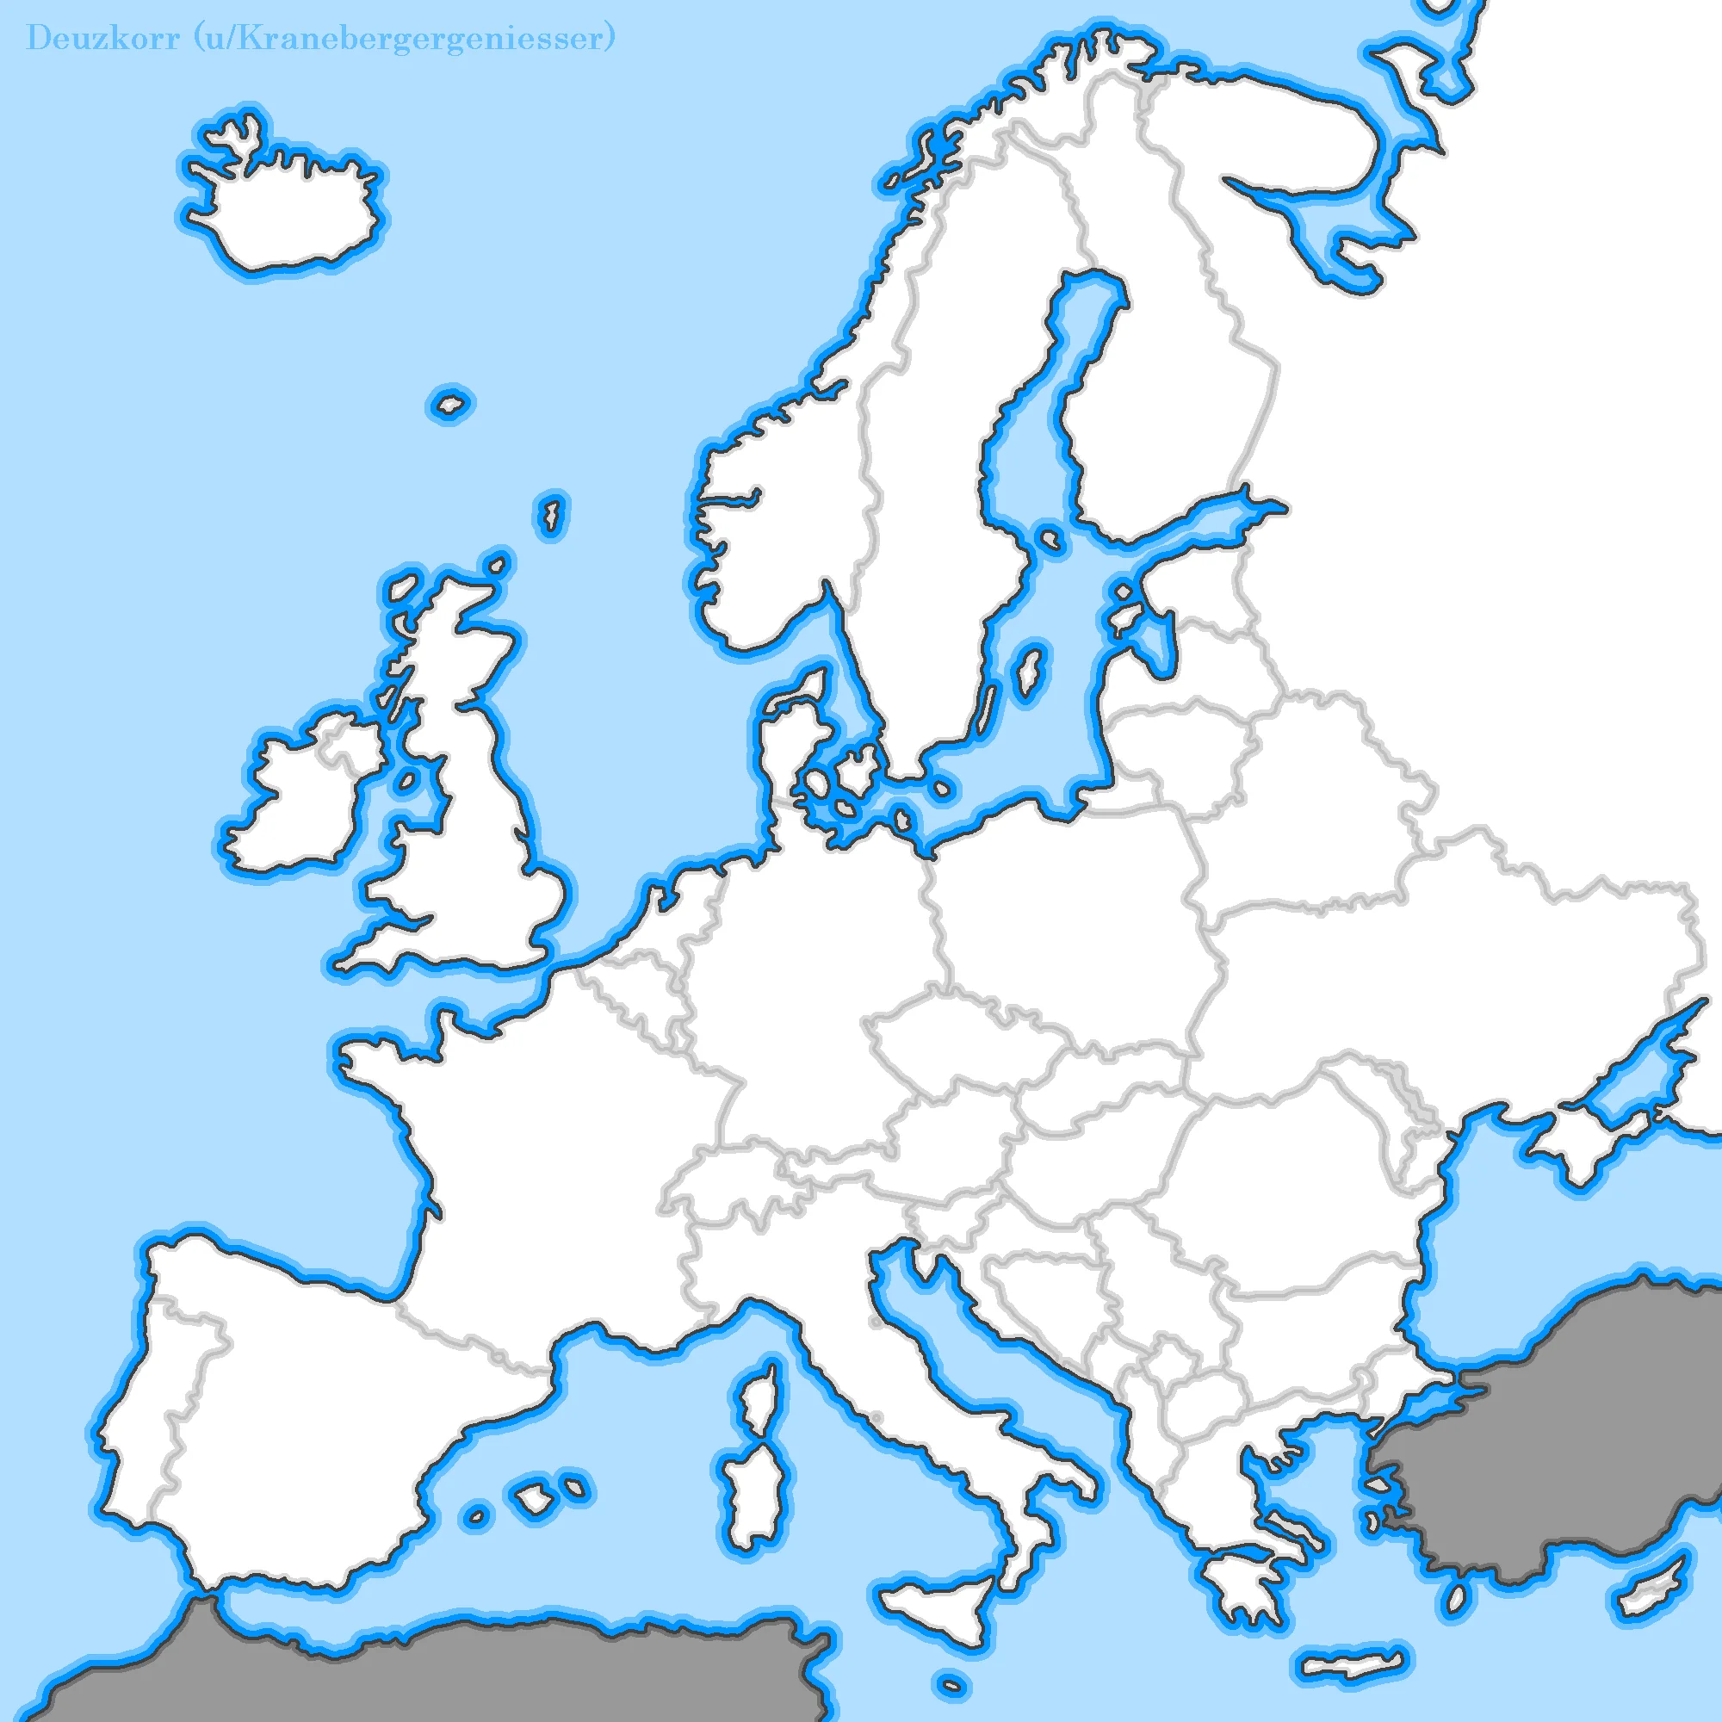

Expansion &
Revenue
2025
€60T
2026
€120T
Total market size – Annual figures
(Nordics, UK, Germany, France, Poland, Spain)
2027
€240T
€98B
Total market: Estimated total collectible debt.
Applicable market: Estimated total soldable debt. 40% of the total collectible debt.
Target market: Target is 2% of the applicable market.
Target capital traded via BidWise: based on our calculations.
Revenue expectation: 2-5% from the traded capital.
€39B
2029
€2.8M
2028
€0.7M
€800M
€150M
€3-6M
2030
+€7M
Notes:
The market for selling overdue receivables is growing, with buyers increasingly interested in opportunities from smaller companies.
This map outlines our growth plan, starting in Finland in 2025 and expanding across the Nordics and Central Europe by 2030.
On the figure side you can see, the total debt market in these regions is around 98 billion euros, with 39 billion euros sellable receivables. Our initial target is 2% of this, which counts to 800 million euros.
By 2030, BidWise aims to handle 150 million euros in traded capital, generating 3 to 6 million euros in annual revenue through transaction fees.
With a clear roadmap and scalable model, BidWise is set to transform this market.

Slide 7




Faster, Simpler & Smarter way to trade
To bring this vision to life, we are seeking an investment of €100,000 to develop our platform, onboard partners, and launch in Finland by 2025.
This was super easy!
Tell me about it! Epic!
Eppu Hassinen - Jarmo Tahvanainen - Risto Teerikoski
Notes:
So, BidWise. A faster, simpler, and smarter way to trade overdue receivables.
To make this vision a reality, we are seeking an investment of €100,000. This will help us develop our platform, onboard key partners, and successfully launch in Finland by 2025.
Join us in transforming the receivable trading market."

Slide 8

Metrics
targets

